Slide 1
Geometric line sweep

Slide 2
What is it?
We move an imaginary line over a set of points
We stop at every point to do geometric operations
Once the line has ‘swept’ over every point, the program is done (In some situations, sweeping more than once is required)
This can be used to find:
  The minimum distance between any 2 points on a plane
  The point where a certain amount of rectangles overlap on a plane
  The total area covered by the union of some rectangles on a plane (not shown in this presentation)
  All intersections of line segments on a plane (not shown in this presentation)

Slide 3
How does finding the minimum distance work?
Sort all of the points by their x value
Store the current smallest distance between points (h, h = INF originally)
Store a list of all elements whose x coordinate is within h of the current x coordinate (and then order the elements in this list by their y coordinate)
When we move to a new element, remove all elements whose x value is now greater than h from the current point.
Run through all elements in that list whose y value is within h of the current y coordinate
If the distance between the current point and that point is less than h, update h
The solution can be brute forced in O(n²) by comparing every point, but the line sweep works in O(nlogn), making it much more efficient
finding closest pair of points in O(n log n) time

Slide 4
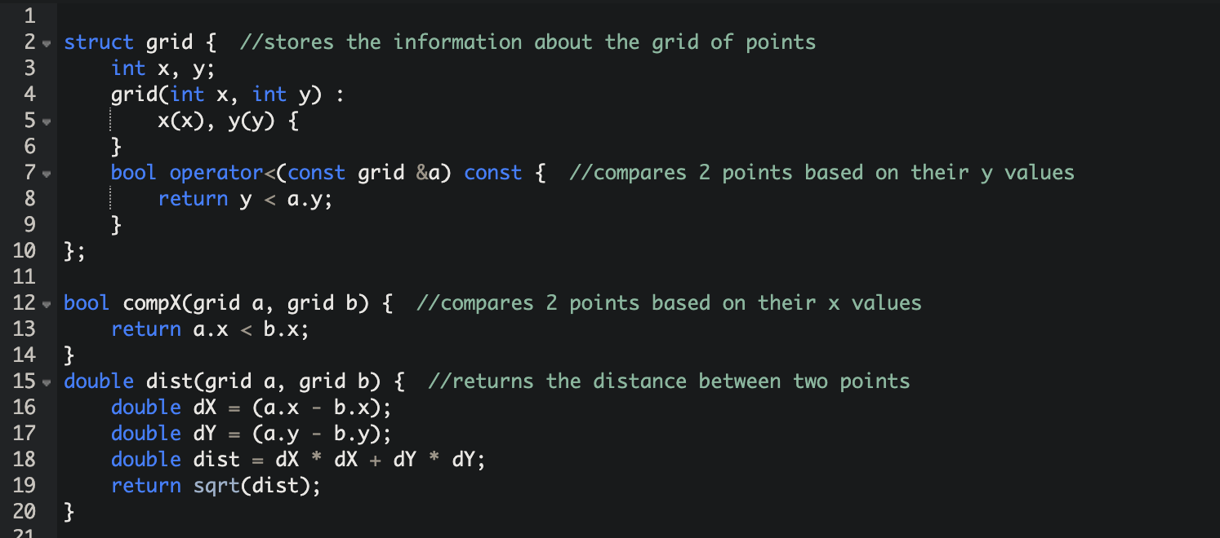
setup Code:

Slide 5
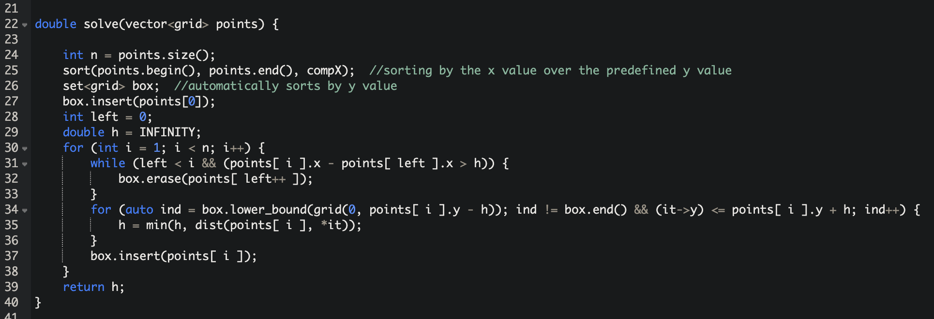
Solving Code:

Slide 6
Codeforce 1028c - rectangles
Given: the bottom left and top right coordinate of n rectangles on a plane
Find a point that is on the boundary of or is inside n-1 or n rectangles (there can be more than one answer)
Brute force is too slow
finding closest pair of points in O(n log n) time

Slide 7
Codeforce 1028c - rectangles
SOLUTION
Run a vertical line through the starting point of every rectangle, store the x value of the ending point of every new rectangle *
When we move to a new rectangle, remove all rectangles that are now too far away (using their endpoint)
If the line is covering n-1 or n rectangles, store that x
Repeat with a horizontal line to find the y values
Go through every combination of those x and y values to see if any work (this is not optimal, but there will be at most 2 of each, so it doesn’t matter here)
Another solution is to do a horizontal line sweep every time the vertical line is covering n-1 or n rectangles, but only line sweep through the rectangles that are being covered by the vertical lines.
* As multiple rectangles can have the same x value at the end point, a multiset must be used over a set, unlike in the previous example
finding closest pair of points in O(n log n) time

Slide 8
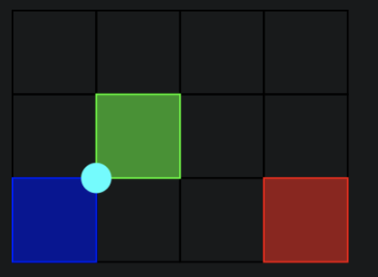
Codeforce 1028c - rectangles
Eg:
The vertical line only finds x = 1
The horizontal line finds y = 0 and 1
Test (1,0) and (1,1) to find that (1,1) works

Slide 9
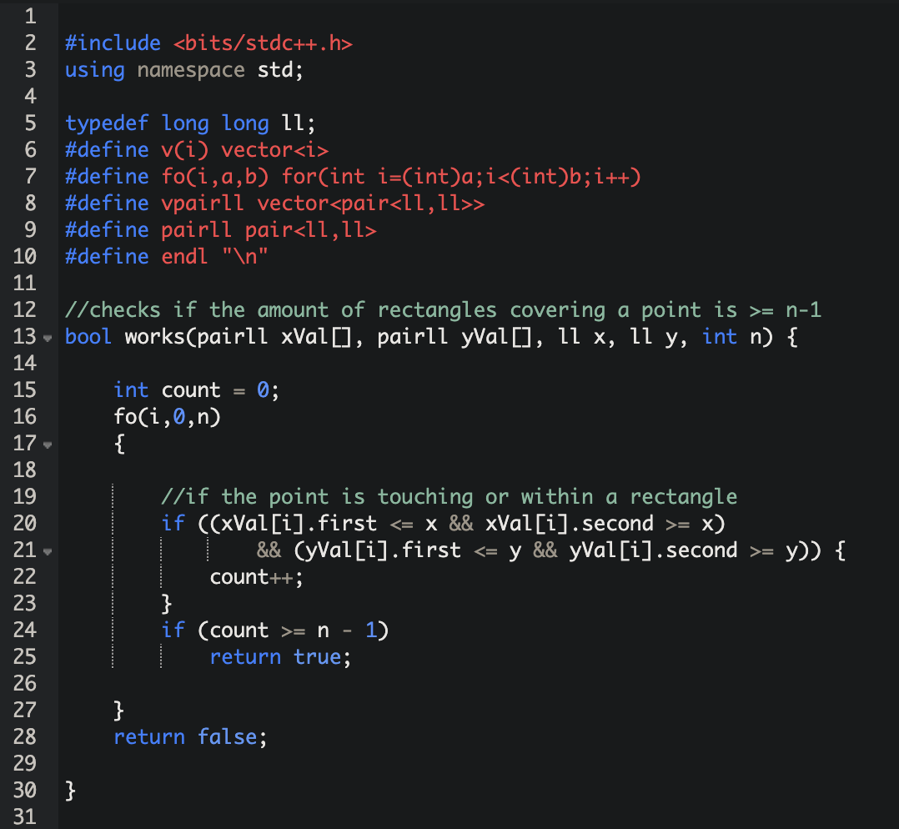
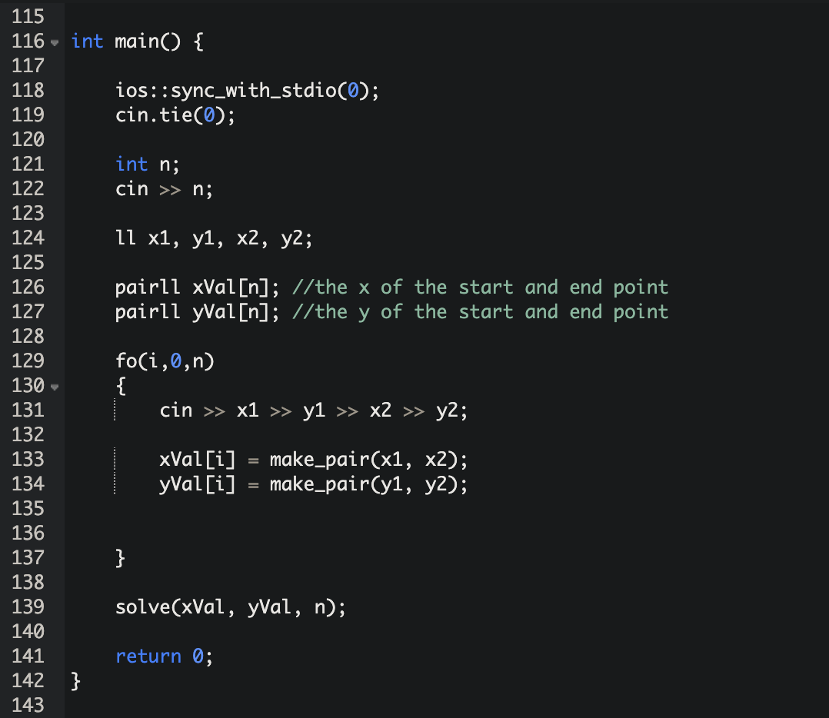
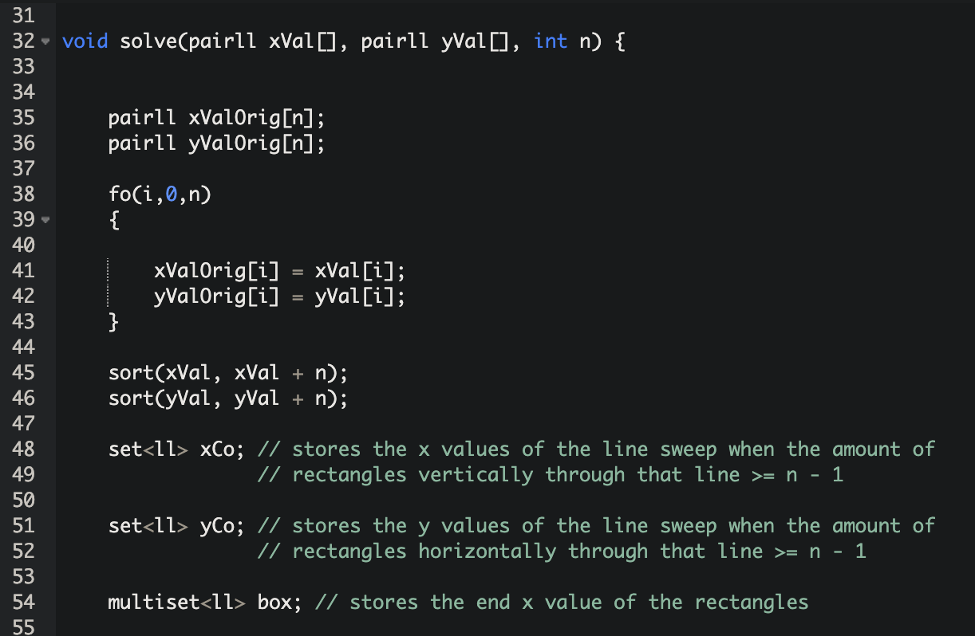
CODE
SETUP
MAIN CLASS
SOLVING METHOD SETUP

Slide 10
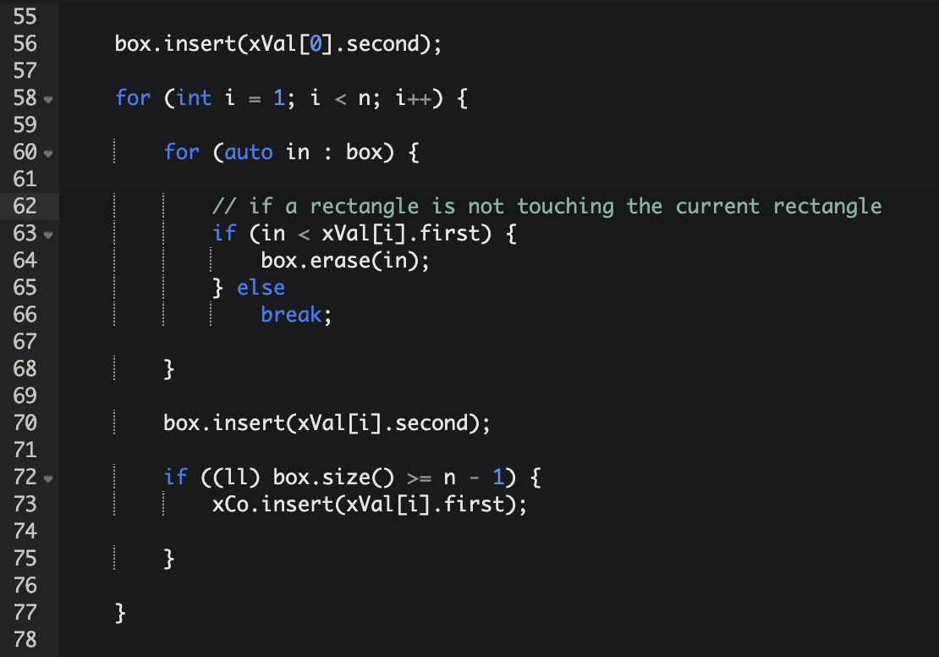
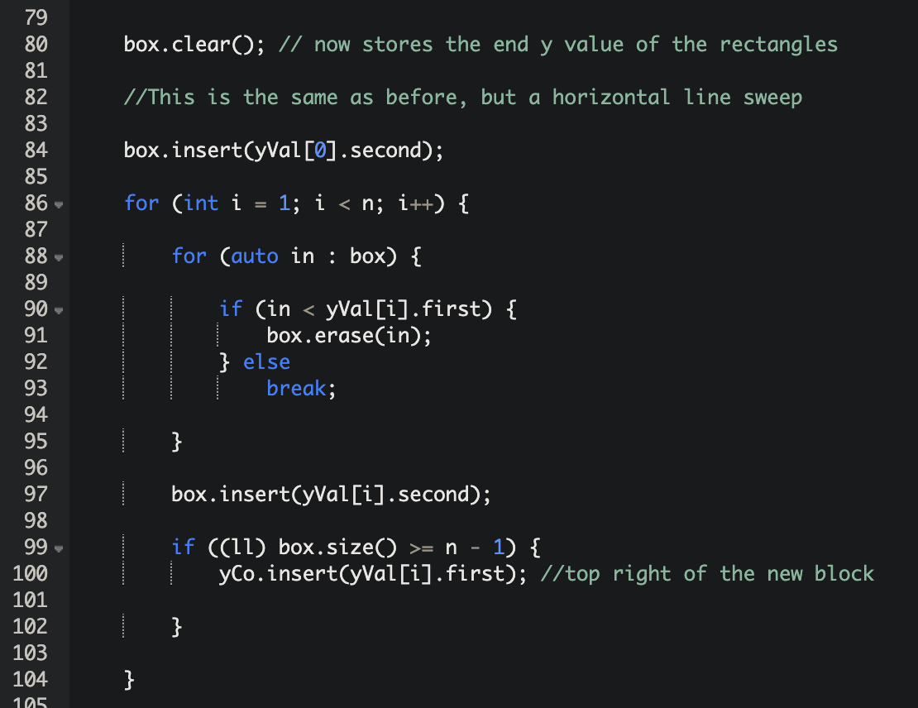
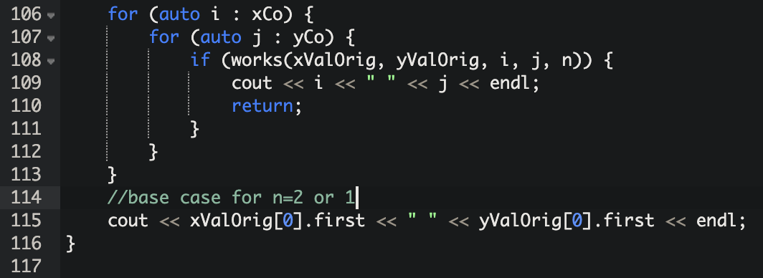
CODE
VERTICAL SWEEP
HORIZONTAL SWEEP
While this code does work for the codeforce problem, it can be easily optimised by exiting the outer for-loop once two rectangles have been removed
RUNNING THROUGH POSSIBLE SQUARES

